Slide 1
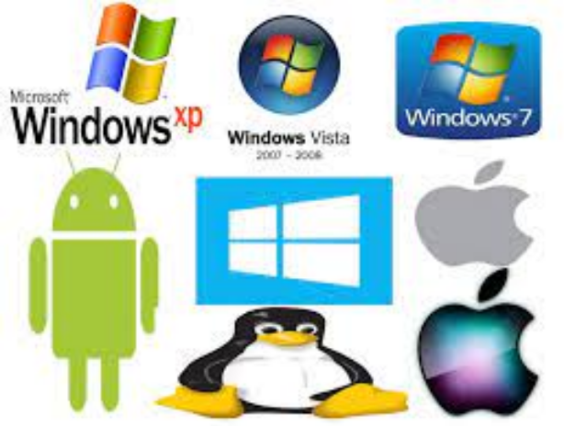
Unit 5.1 - System Software
Prepared by: Koh Kian Hua

Slide 2
Objectives
After completing this unit, students should be able to:
Explain why a computer system requires an Operating System (OS).
Explain the key management tasks carried out by the Operating System (eg: memory management, file management, security management, hardware management and process management).
Show understanding of the need for typical utility software provided with an Operating System.
Show understanding how existing codes from program libraries can be used in software dvelopment and the benefits of using program library files (eg: dynamic link libraries).

Slide 3
System Software
Need for an Operating System (OS)
Early Computers do not have an operating system.
Control software had to be loaded each time the computer was started
This was done using either paper tape or punched cards.
An Operating System (OS) seves the following purposes.
provides both the environment in which applications can be run.
provides a useable interface between humans and computer.
it also disguises the complexity

Slide 4
System Software
Features of Modern Computer Systems
Modern computer systems has the following characteristics:
operating systems were stored on the hard disk.
start-up of the motherboard was handled by the basic input/ output system (BIOS).
the BIOS contents are stored on a flash memory chip.
BIOS configuration is stored in CMOS memory (complementary metal-oxide semiconductor) which means it can be altered or deleted as required.

Slide 5
System Software
Human Computer Interaction
The environment that humans interact with a computer can be achieved using.
  graphicaluser interface (GUI)
  a command line interface (CLI)
In order to use a command line interface (CLI), the user has to:
  type instructions to choose options from menus and open software etc.
  learn a number of commands (which must be typed exactly with no errors) just to carry out basic operations.
  takes time to key in commands every time an operation has to be carried out.
Advantage of CLI: User is in direct communication with the computer and is not restricted to a number of pre-determined options.

Slide 6
System Software
Human Computer Interaction
GUIs (Graphical User Interface) use various technologies and devices to provide the user interface.
Some commonly used GUI environments includes: windows, icons, menu and pointing device (WIMP), which are developed for use on personal computers (PCs).
  a mouse is used to control a cursor
  icons are selected to open and run windows.
  Each window contains an application.
  Modern computer systems allow several windows to be open at the same time.

Slide 7
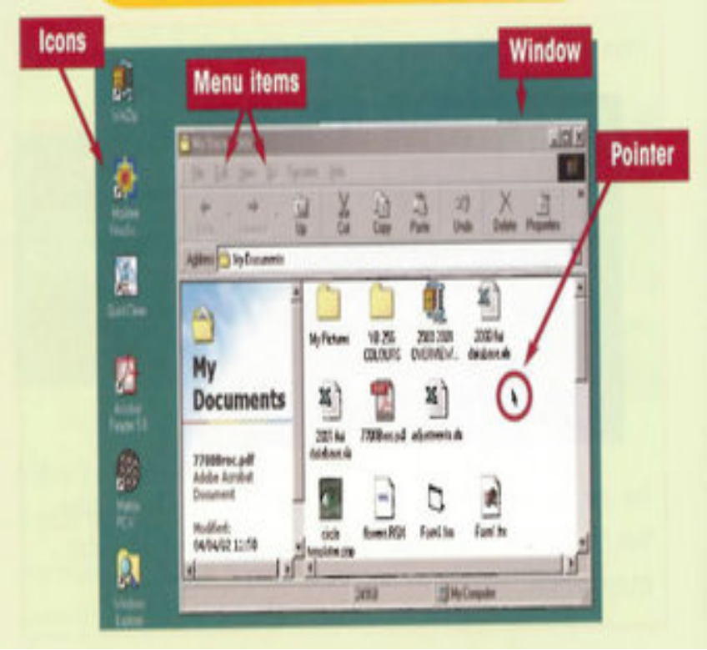
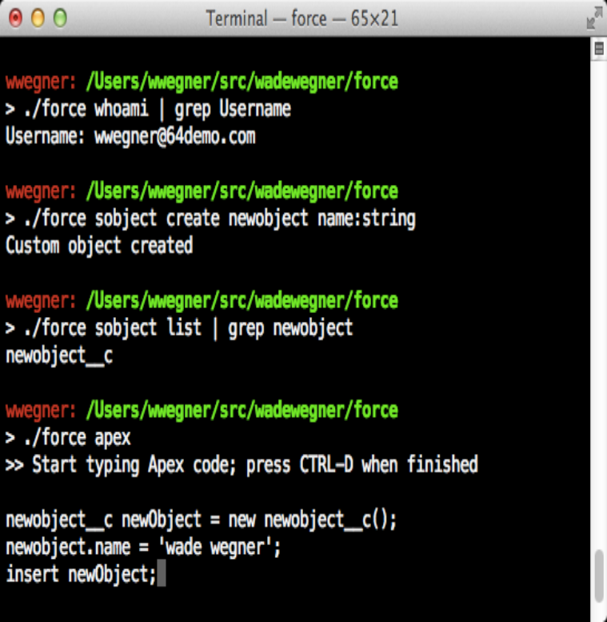
System Software
Human Computer Interaction
A Graphical User Interface (GUI)
A Command Line Interface (CLI)

Slide 8
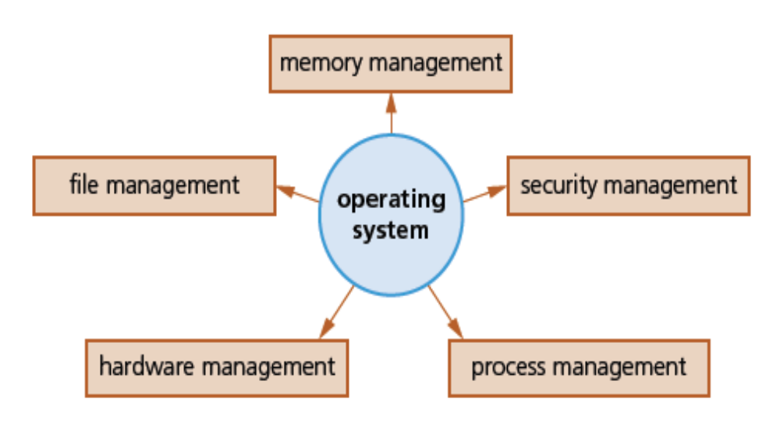
System Software
Operating System Tasks

Slide 9
System Software
Operating System Tasks
Memory Management: the management of a computer’s main memory. It consist of three parts:
  memory optimisation: determine how computer memory is allocated and deallocated when applications are running simultaneously. It also determines where processes are stored in memory and keeps track of all allocated memory and free memory available for use
  memory organisation: determines how much memory is allocated to an application, and how the memory can be split up in the most appropriate or efficient manner. This can be achieved using a single (contiguous) allocation, partitioned allocation, paged memory, segmented memory.
  memory protection: ensures that two competing applications cannot use the same memory locations at the same time. If this was not done, data could be lost, applications could produce incorrect results.

Slide 10
System Software
Operating System Tasks
Security Management: function is to ensure the integrity, confidentiality and availability of data.
This can be achieved through:
  carrying out OS updates when they are available
  ensuring antivirus software are up to date
  commuicate with firewall to check for network traffic access
  maintaining access rights for all users
  offering abilt for recovery of data that has been lost or corrupted
  prevent illegal intrusion to the computer system.

Slide 11
System Software
Operating System Tasks
Process Management: involves the allocation of resources and permits the sharing and exchange of data, thus allowing all processes to be fully synchronised (eg: resources scheduling and process scheduling queues).
Hardware Management: involves all input and output peripheral devices. The functions of hardware management includes:
  communicating with all input and output devices using device drivers
  translating data from a file into a format that the I/O device can understand using device drivers
  ensuring each hardware resource has a priority so that it can be used and released as required.

Slide 12
System Software
Operating System Tasks
File Management: The main tasks of file management include:
  defining the file naming conventions which can be used
  performing specific tasks, such as create, open, close, delete, rename etc
  maintaining the directory structures
  ensuring access control mechanisms are maintained
  specifying the logical file storage format (such as FAT or NTFS if Windows is being used).
  ensuring memory allocation for a file by reading it from the HDD/SSD and loading it into memory.

Slide 13
System Software
Utility Software
Many computers come with a number of utility programs that are part of the operating system. In addition, users are also able to install their own utility sofware.
Utility software that are offered by most operating system includes:
» hard disk formatter
» virus checker
» defragmentation software
» disk contents analysis/repair software
» file compression
» back-up software

Slide 14
System Software
Utility Software
Hard-Disk Formatter: organise storage space by assigning it to data blocks (partitions). The partitions are contiguous block of data
  partitions are formatted once they are created
  table of contents used to find a file on disk surface
  different OS will use different file system (eg: NTFS for indows)
  disk formatters have checking tools to detect bad sectors (error files)
  bad sectors are replaced with new unused sectors to repair the faulty disk
Table below shows that bad sectos can be classified as hard and soft
Hard bad sectors (difficult to repair) | Soft bad Sectors
caused by manufacturing errors | sudden loss of power leading to data corruption in some of the sectors
damage to disk surface caused by allowing the readwrite head to touch the disk surface | effect of static electricity leading to corruption of data in some of the sectors.
system crash which could lead to damage to the disk surface(s)

Slide 15
System Software
Utility Software
Hard-Disk Formatter:Running antivirus software in the background can check for virus attacks. Various types of antivirus software have some common features.
They are:
  check software or files before they are run or loaded on a computer
  compare possible viruses against a database of known viruses
  carry out heuristic checking – this is the checking of software for types of behaviour that could indicate a possible virus
  put files or programs which may be infected into quarantine, to
    – automatically delete the virus, or
    – allow the user to decide whether to delete the file (it is possible that the
  user knows that the file or program is not infected by a virus

Slide 16
System Software
Utility Software
Defragmentation Software: takes the fragmented files and rearranges the segments so that they run contiguously. This decreases read/write time, thereby speeding up computer performance.
As an HDD becomes full, blocks used for files will become scattered all over the disk surface.
This happens as files are deleted, partially-deleted, or extended.
  The consequence is slower data access time: the HDD read-write head
  requires several movements just to find and retrieve the data making up the required file.

Slide 17
System Software
Utility Software
Disk Analysis / Repair Software: used to check disk drives for empty space and disk usage by reviewing files and file folders.
  optimal use of disk space by the removal of unwanted files and downloads, eg: deleting of auto saved files, cookies, downloaded files etc.
Disk Compression Software: save storage space and make it quicker to download/upload files and quicker to send files via email.
  less common these days due to the vast size of HDDs (often more than 2 TB).
  compresses data before writing it to hard disk (and decompresses it again when reading this data)
  high priority utility and will essentially override all other operating system routines.

Slide 18
System Software
Utility Software
Backup Software: used to make a digital copy of the electronic documents, folders, and drives. This utility will:
  allow a schedule for backing up files to be made
  only carry out a back-up procedure if there have been any changes made to a file
For security reasons, there should be three versions of a backup file:
The current (working) version stored on the internal HDD.
A locally backed up copy of the file (stored on a portable SSD).
A remote back-up version stored well away from the computer (using cloud storage).

Slide 19
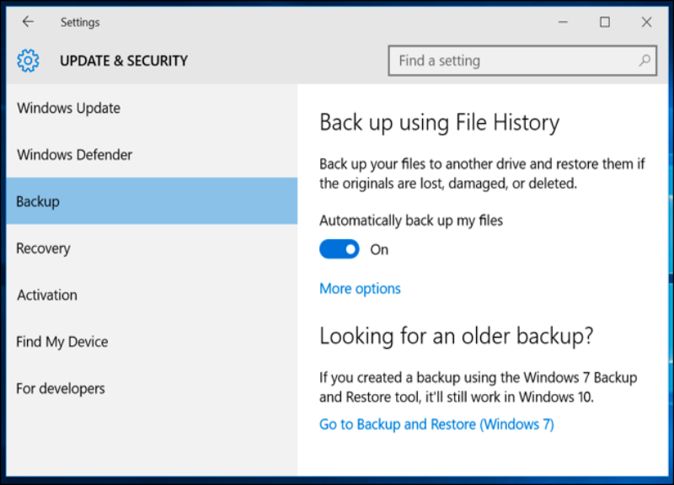
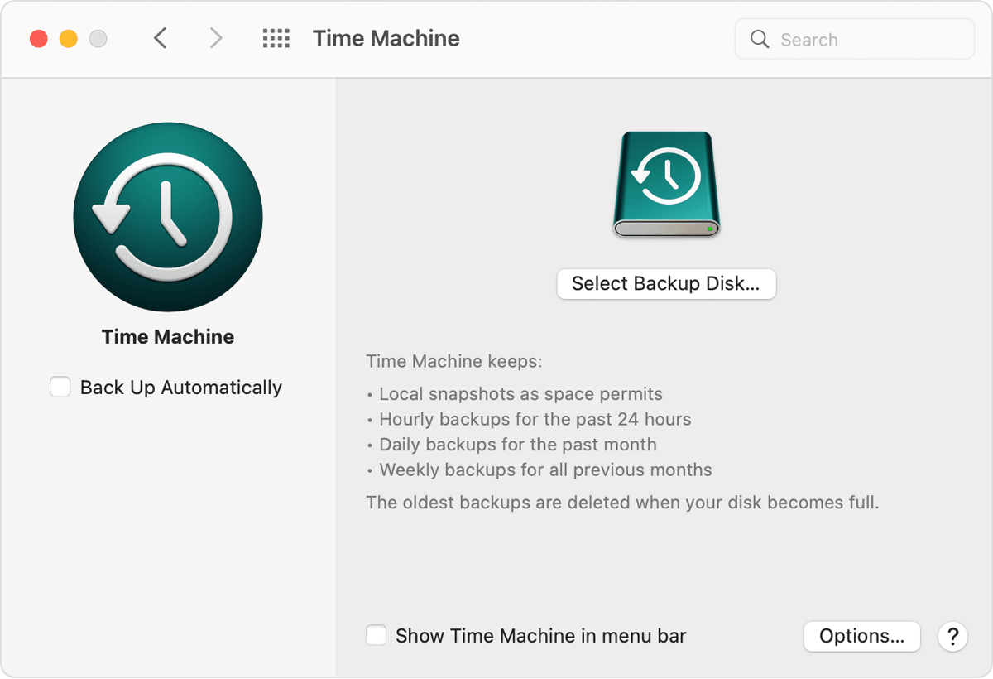
System Software
Utility Software
Backup Software for Windows and Mac
Windows uses File History, which takes snapshots of files and builds up a vast library of past versions of files and let user choose which version they want to use.
Mac OS offers the Time Machine back-up utility. This erases the contents of a selected drive and replaces them with the contents from the back-up

Slide 20
System Software
Utility Software
Program Libraries: a collection of programs and software packages that are made available for common use within some environment.
Program libraries are used:
  when software is under development and the programmer can utilise pre-written subroutines in their own programs, thus saving development time.
  to help a software developer who wishes to use dynamic link library (DLL) subroutines in their own program.
Note: When software routines are written (such as a sort routine), they are frequently saved in a program library for future use by other programmers.

Slide 21
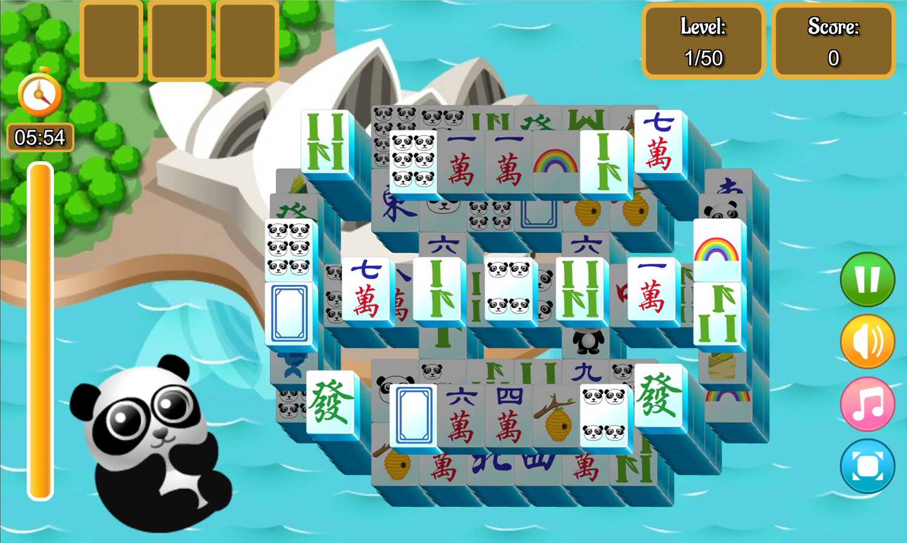
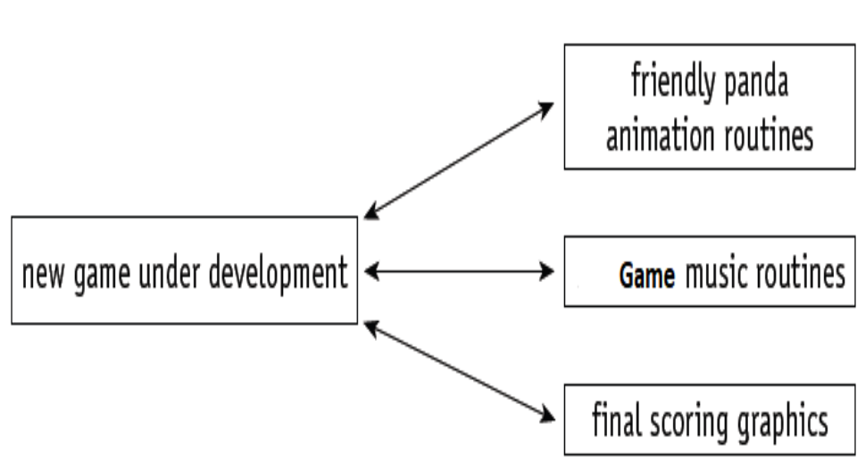
System Software
Utility Software
Program Libraries for Software / Game Development

Slide 22
System Software
Utility Software
Program Libraries: Developing software using / program routines can help to:
  remove the need to rewrite the many routines every single time
  lead to modular programming, which means several programmers can be working on the same piece of software at the same time
  save considerable development time having to test each routine, since the routines are all fully tested in other software and should be error-free.

Slide 23
System Software
Utility Software
Program Libraries: can be classified as static or dynamic.
  Static libraries: the library routines is embedded directly into the new executable program code at the time of compilation.
  Dynamic libraries: software being developed is not linked to the library routines until actual run time. These library routines are stand-alone files only being accessed as required by the new program.

Slide 24
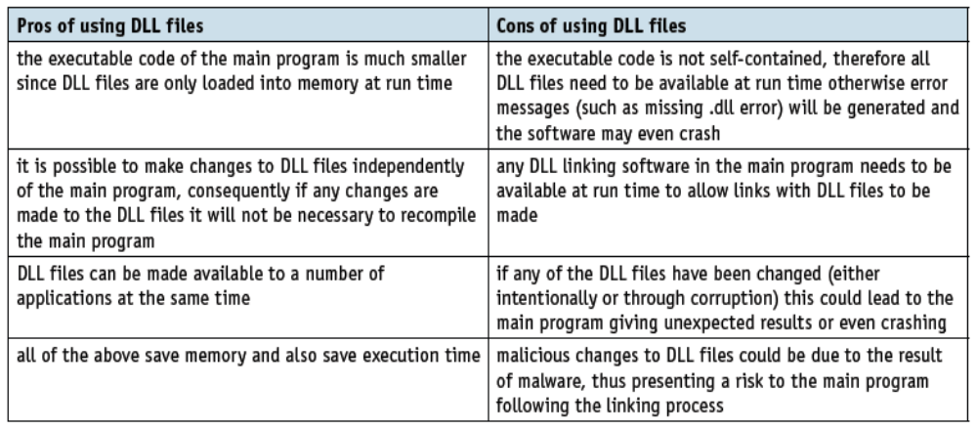
System Software
Utility Software
Pros and Cons of using DLL files:

Slide 25
System Software
Class Activity
1a) Explain why a computer needs an operating system.
1b) Name two management tasks carried out by the operating system.
2) Explain what is meant by a DLL file. How does this differ from a static library routine?

